Slide 1

Soldiers Surf Free
Segev Olpak, Ofek Yabo, Dolev David, Guy Yehoshua

Slide 2
Current Project Status
rocket_launch
Beta Readiness
Full beta version ready except donation (scanning algorithm, user management, site manager dashboard complete).
architecture
Code Refactor
Big refactor done and finished, ensuring a cleaner and more maintainable codebase.
fact_check
Testing & Quality
Changed and improved the test suite to ensure robust system reliability.
check_circle
Field Deployment
System is fully ready for deployment in the field.

Slide 3

Current Tests Status
Total Tests in Suite: 51
20
Unit Tests
12
Integration Tests
10
System Tests
8
API Acceptance Tests
1
Smoke Test

Slide 4
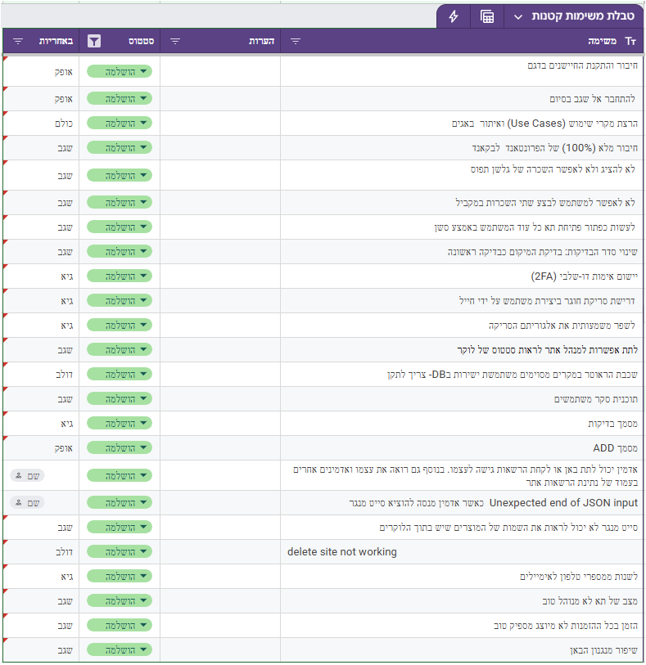
Completed Tasks

Slide 5

Overall Coverage Assessment
User Journey
The soldier-facing borrow and return journey.
Access Security
Document, reservation, and location gates protecting the borrowing process.
person
security
Physical Validation
Preconditions: item presence detection and door closure verification.
Admin Controls
Active-rental reopen behavior and administrative access provisioning.
sensor_door
admin_panel_settings
Operational Workflows
Site-manager localized workflows and operational procedures.
IoT & Event Logic
Real-time IoT message parsing and system-wide event processing.
account_tree
settings_input_antenna

Slide 6
Unit Tests
Authentication & Access
Principal resolution from API Gateway and role enforcement for soldier, site-manager, and admin scopes.
Validation Rules
Active-ban behavior and required document validation before borrow actions.
vpn_key
fact_check
Site Policy
Enforcement for walk-ins and daily rental limits according to site policy.
Reservation Handling
Logic for reservation reuse and handling no-show scenarios effectively.
policy
event_busy
Geofencing
GPS-distance enforcement against site policy to ensure localized operations.
IoT Processing
IoT payload parsing and classification for real-time system integration.
location_on
settings_input_antenna

Slide 7

Integration Tests
Identity & Security
Backend military-ID verification against encrypted stored values and role resolution.
Data Logic
Repository filtering for bans, rentals, reviews, and admin hierarchy traversal.
security
filter_alt
Hardware Triggers
RFID-triggered commands for active rentals and telemetry-driven state updates.
System Integrity
Persistence integrity for sites, lockers, cells, reservations, and system commands.
sensors
storage

Slide 8

Acceptance & System Tests
Soldier Journey
Full process from borrow preconditions to return completion and state transitions.
API & Conflict Handling
Reservation conflicts and no-show behavior at the live API level.
directions_walk
api
Hardware Access
Active-rental reopen, door-close confirmation, and cell state reflections.
Incident Management
Malfunction reporting (item, locker, site) and manager responses.
meeting_room
report_problem
Admin & Manager Control
Operational overrides, site scoping, provisioning, and access-control.
admin_panel_settings

Slide 9

Complex End-to-End Test Case
TEST ID: test_borrow_flow_enforces_documents_reservation_policy_and_distance
description
Document Validation
Valid documents unblock the stage; missing ones cause immediate rejection.
policy
Site Policy Enforcement
Systems verify if site-specific policies require active reservations.
location_on
GPS Proximity Check
Distance checks remain active to reject attempts outside defined GPS range.
shopping_cart
Rental Fulfillment
Once all criteria are met, the rental is successfully created.
sensors
State Transition & IoT Dispatch
Cell status updates to IN_USE. An IoT open command is recorded and dispatched to hardware.

Slide 10
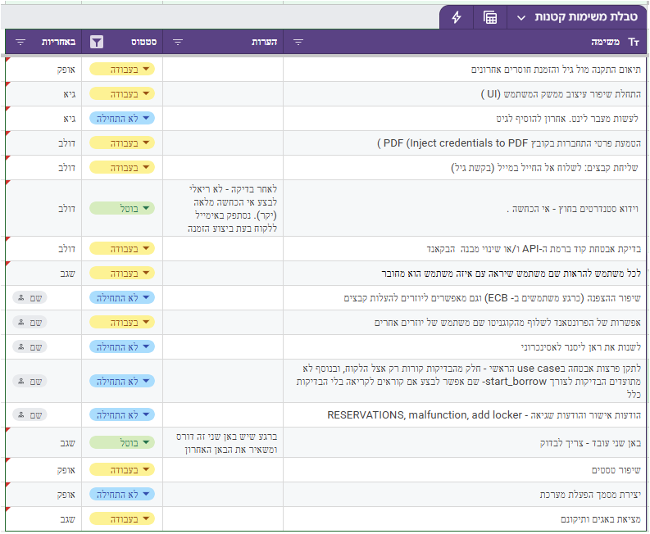
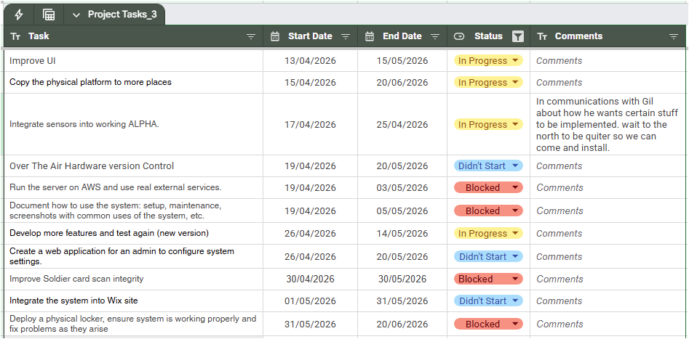
Future
Assignments

Slide 11
Current Project Status
Full beta version ready except donation
(scanning algorithm, user management, site manager dashboard complete).
Big refactor done and finished.
Changed and improved the tests.
Ready for deployment in the field.

Slide 12
Current Tests Status
The current suite contains 51 tests in total:
20 unit tests
12 integration tests
10 dedicated system tests
8 API acceptance tests
1 smoke test

Slide 13
Overall Coverage Assessment
The soldier-facing borrow and return journey.
The document, reservation, and location gates that protect borrowing
The physical return preconditions of item present and door closed.
Active-rental reopen behavior admin provisioning and access control.
Site-manager operational workflows.
IoT message parsing and event processing

Slide 14
Unit Tests
Principal resolution from API Gateway claims and local test headers.
Role enforcement for soldier, site-manager, and admin scopes.
Active-ban behavior.
Required document validation before borrow.
Site-policy enforcement for walk-ins and daily rental limits.
Reservation reuse and no-show handling.
GPS-distance enforcement against site policy.
IoT payload parsing and classification.

Slide 15
Integration Tests
Backend military-ID verification against encrypted stored values
Auth login role resolution across soldier, manager, and admin relations
Repository filtering for bans, active rentals, reviews, and donations
Admin hierarchy traversal
RFID-triggered open-command behavior for an active rental .
Persistence integrity for sites, lockers, cells, reservations, rentals, documents, malfunctions, and commands.
Telemetry-driven cell state updates.

Slide 16
Acceptance And System Tests
The full soldier journey from borrow preconditions into return completion.
Reservation conflicts and no-show behavior at the live API level.
Active-rental reopen and door-close confirmation.
Item, locker, and site malfunction reporting and manager response.
Manager site scoping and admin operational override.
Admin inventory provisioning and access-control changes.
Live borrow/return state transitions reflected in cells, reservations, and commands.

Slide 17
Big Big Test
test_borrow_flow_enforces_documents_reservation_policy_and_distance
Missing documents cause rejection.
Valid documents unblock that stage.
Site policy can require reservations
GPS distance can still reject the attempt.
Once all conditions are satisfied, the rental is created.
The cell enters IN_USE state.
An IoT open command is recorded and dispatched.

